Slide 1
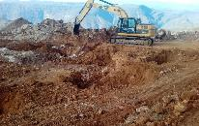
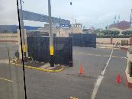
Industry day invitation – 15 march 2023 us army corps of engineers
The United States Army Corps of Engineers (USACE) works with partner nations in the region on engineering efforts and has current construction requirements in Peru. USACE is seeking contractors with experience in design, construction and repair of facilities, utilities, and infrastructure.
A pre-proposal conference is offered to share information on this and other potential requirements. Information will focus on the type of requirements and how to submit a proposal.
Date: Wednesday, March 15
Time: 10:00h
Place: Centro Naval de San Borja, Salón Angamos
Address: San Luis Ave, Block 24, San Borja
Registration required at: claudia.m.montero@usace.army.mil NLT March 10. Provide name, ID number, and vehicle information.
Required Registrations:
Get an NCAGE Code assigned - https://eportal.nspa.nato.int/Codification/CageTool/request-new-cage - It takes up to 14 business days to obtain an NCAGE code.
Create a SAM account and get your Unique Entity Identifier (UEI) Number (formally known as DUNS) at www.sam.gov. Allow up to 15 business days after submission before your registration is active in SAM. For International Registrants, refer to the Quick Start Guide at https://www.fsd.gov/sys_attachment.do?sys_id=c3fbd4771be83898d3ab404fe54bcb19
Obtain PIEE access - https://piee.eb.mil/xhtml/unauth/help/helpvendors.xhtml
NOTE: All solicitations and amendments will be advertised on the website - https://piee.eb.mil.
Contractors are encouraged to register prior to the conference in the systems listed on this page to ensure that they can download solicitations when they become available. Solicitations will only be announced on https://SAM.gov and can only be downloaded from and proposals submitted through https://piee.eb.mil.

